Slide 1

Hidden in Plain Sight: Exploring Encrypted Channels in Android apps
Sajjad Pourali, Nayanamana Samarasinghe, Mohammad Mannan
Concordia University, Montréal, Canada
ACM CCS 2022, November 9, 2022

Slide 2


Apps leak data
Communicate using different channels: HTTP/S, raw TCP/UDP
Process/Obfuscate data: serialize, encrypt, compress

Slide 3

Motivation
HTTPS
百度
GET+/v.gif?cuid=B868BFF1EAC2787DFE6EBE1660FA5746&clientid=B868BFF1EAC2787DFE6EBE1660FA5746&appversion=12.3.0.9&di=2816260680380110_Oy%2FX7kOLwii6wDVMPd90IZqbI3EnuSNyfcdonERgz71102zxt%ZeSFW7GOjrABDvOY5WTWzxIIVZZZM7862gnr6Nzif9sEmBYN4WagDAkzYHlPOpckw3vPxZKOparTAEX5qxVSczK%2BbRsM1RlTpjdmem0&2BOE3V%2FZ32SiCjDmOJ19v55d7P4AuL9MFInltGrf03Rag2BOgzMFTell%2FyGdm3TOyZAPu6bJEN1pF1hFYcEHtgCocSaH6TPA7dh3 1wyWakr6Z682FmeVRfESSynvibxuhe00Z440182BgluIj949p5Hx0mP10xpCwEXd6euTzysa3BUliflQ0MABUvbn05p20gnwQeanXOmfd6upKXfD2nE5CxoZtms8dIzLmfql4M7Zzqz0V&2ByiSWSsoUToBYipn9QQnAldD%2F%2BSTulVCHeViQz0Ve8gpkUVcEVfL9jx2LLP58zTt3%2BX80CEdfu9Hnm4gn3DIRSPYuWIAx2DNONoUdKgQ5kvJbloa7rS%2BkAh%2FRgrizyhhQb5wHxa79wUN67luA8faUA:2FbfC943XXp6YEUn61X0&2FZRrkE%2Bt6ZV7B6r4vIBzffZvExqotRU9CeCqYT5u2NUbCrfyeyT6V04hlsyP074rI00%2FcDJ2Tf%2FzLm5AfHB%2F6iIlIp4GRvPIQbaCeG6BptIe4I6zTFXvV5F228EmHcS8Xid6s%2FMFr77shPMR1F3NPK133y6hdDYpggQWqAFVmHnL5Kv2FNSdrAhgoit2BFbfppv0882FRLrSvgXCOPBcoQbEZeC12LWNEz2FNqUb4Mdc3FdE159bCEN1JW%2BKQjfxSqtiKDrBx63X88SIQueTDqdUTD61aZDD31p7w3D3Dd4aa45&pid=11l&clientfrom=mobilesdkenhanced&type=1023&sig=7bcf62flf2e8216fd5fa00dbc46b67c7&tpl=bsandr&sdkversion=9.1.5.6&zid=1z3JxpUtRW3uvSp96PloC460RhPbzigzOR7G80DnTrKTONwqkSIjsmotGqQE3cAEaQioKeSrXs4mnvz6rCmjA&v=1626068038276&clientip=10.42.0.79&appid=l&sdkversion=9.1.5.6&name=dvif interface&client=android&device=Pixel+4 HTTP/1.1
User-Agent: Dalvik/2.1.0 (Linux: U; Android 11: Pixel 4 Build/R03A.210605.005)
Host: nsclick.baidu.com
Connection: close
Accept-Encoding: qzip, deflate
com.baidu.searchbox.lite.4.14.0.9.8.9.0.1.2.Pixel4.11.android.B868BFF1EAC2787DFE6EBE1660FA5746.bs_andr_lite.o../static/appsapi/conf/android-conf.txt.1..WIFI.false..841b7726b925.25.phantom-ev-10.173.1.c8f9f9a0e932.33.ConcordiaGuest.2.c8f9f9a0e931.33.eduroam.2.c8f9f9a0e930.35.ConcordiaUniversity.2.c8f9f9a0e93d.43.ConcordiaUniversity.2.c8f9f9a0e93e.43.eduroam.2.c47d4f4c4092.52.ConcordiaGuest.2.c47d4f4c4090.53.eduroam.2..android.ae:84:83:82:b4:48.AArch64Processorrev14(aarch64).5583432.52443116.49976460.359..com.baidu.searchbox.lite.10.42.0.79.Pixel4...=..074F6B0CA1B23B51911B6EC52D3A4008D6..
Encrypted
com.baidu.sapiz.utils.AES.encrypt()
App Name
Device Info: Device Model, Android Version, Local IP Address, WiFi Mac Address
Wifi Info: ESSID, BSSID, Channel

Slide 4
Related work
Obfuscation-Resilient Privacy Leak Detection for Mobile Apps Through Differential Analysis (NDSS '17)
Checks privacy leakages via obfuscated channels
Only covers deterministic networks (unchangeable)
Relies on differential analysis
Detects few predefined privacy-sensitive items

Slide 5
Related work (cont'd)
50 Ways to Leak Your Data: An Exploration of Apps' Circumvention of the Android Permissions System (USENIX ‘19)
Looks at unauthorized access and transmission without permissions
Does not cover privacy leakage via encrypted channels
Insufficient hard-coded encryption keys detection 153/88,000 apps

Slide 6

Research Questions
What
How
Who
What
Custom
Encryption
Who

Slide 7
Our Approach
Explore custom encrypted channels and access to their cryptographic parameters
let $plaintext = gzip_compress("BSSID");
encrypt($plaintext,"Key","IV") → Q2lwaGVydGV4dA==
https://example.com/doc-id/Q2lwaGVydGV4dA/page/2

Slide 8
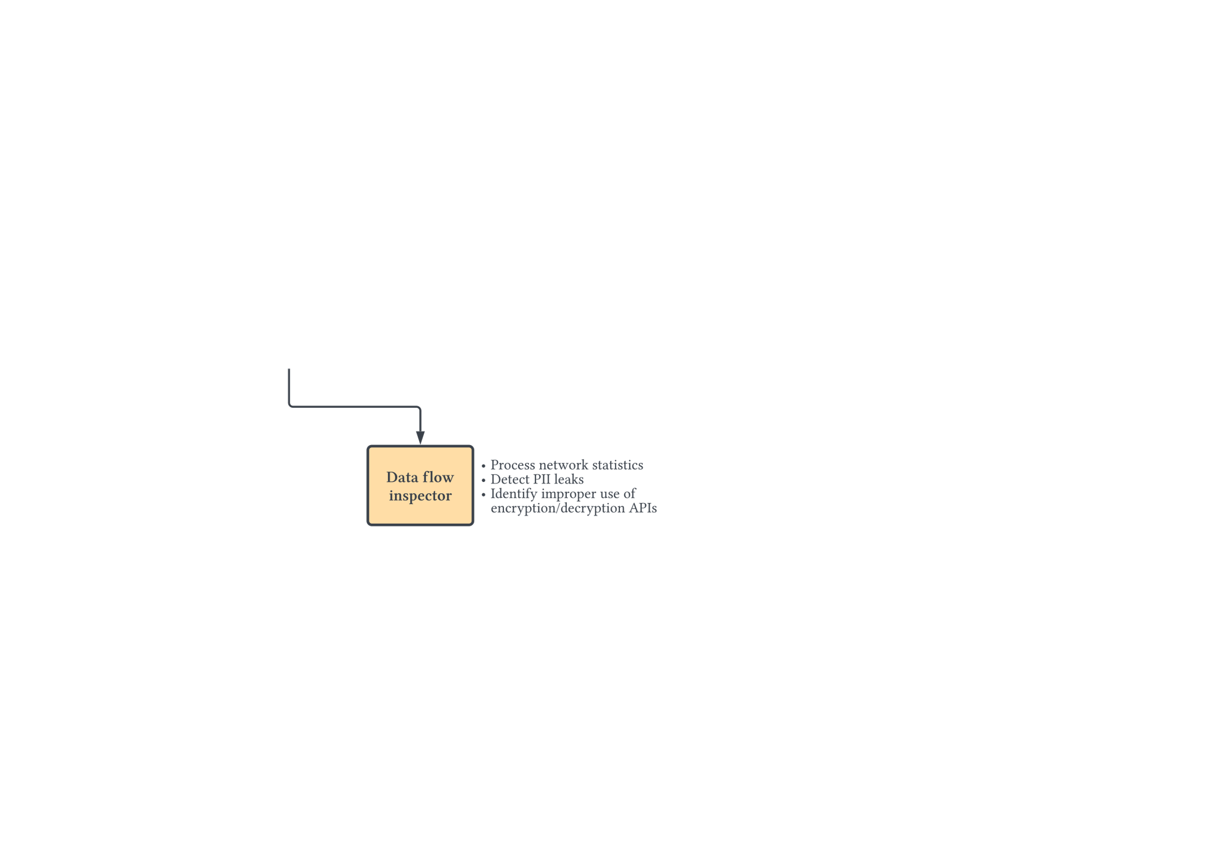
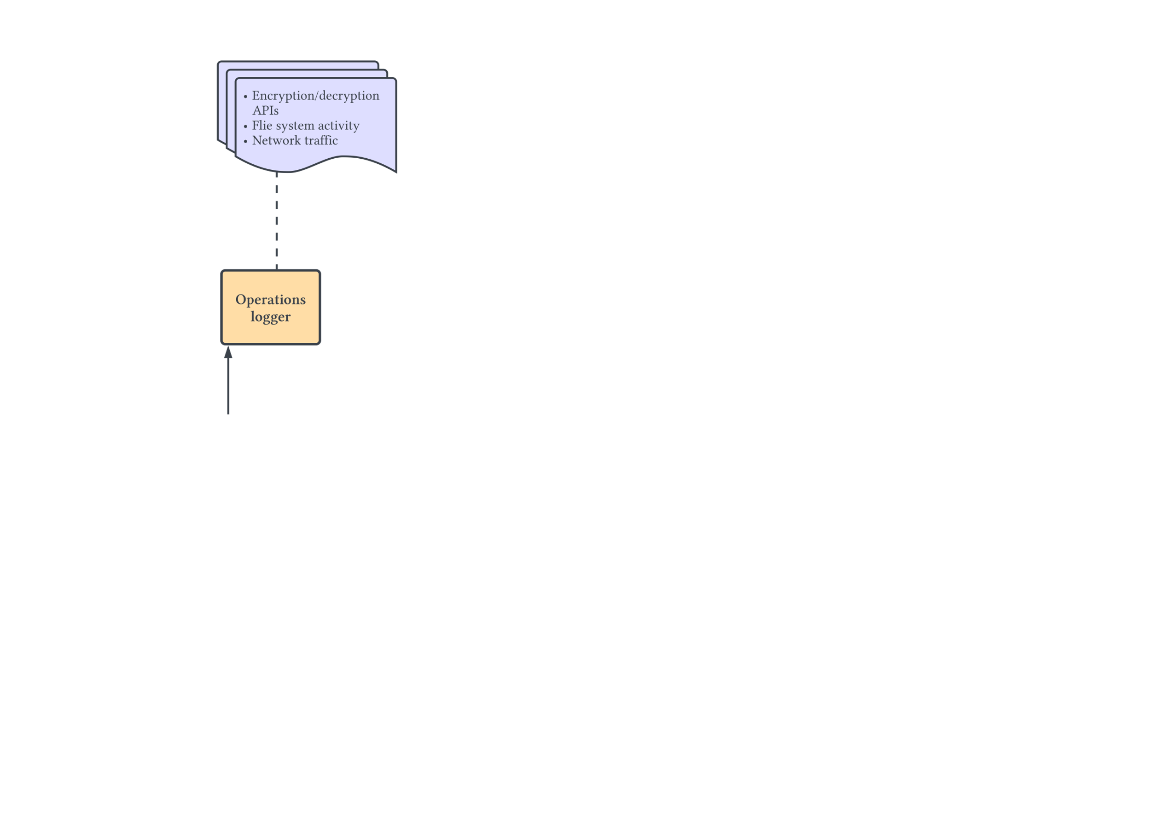
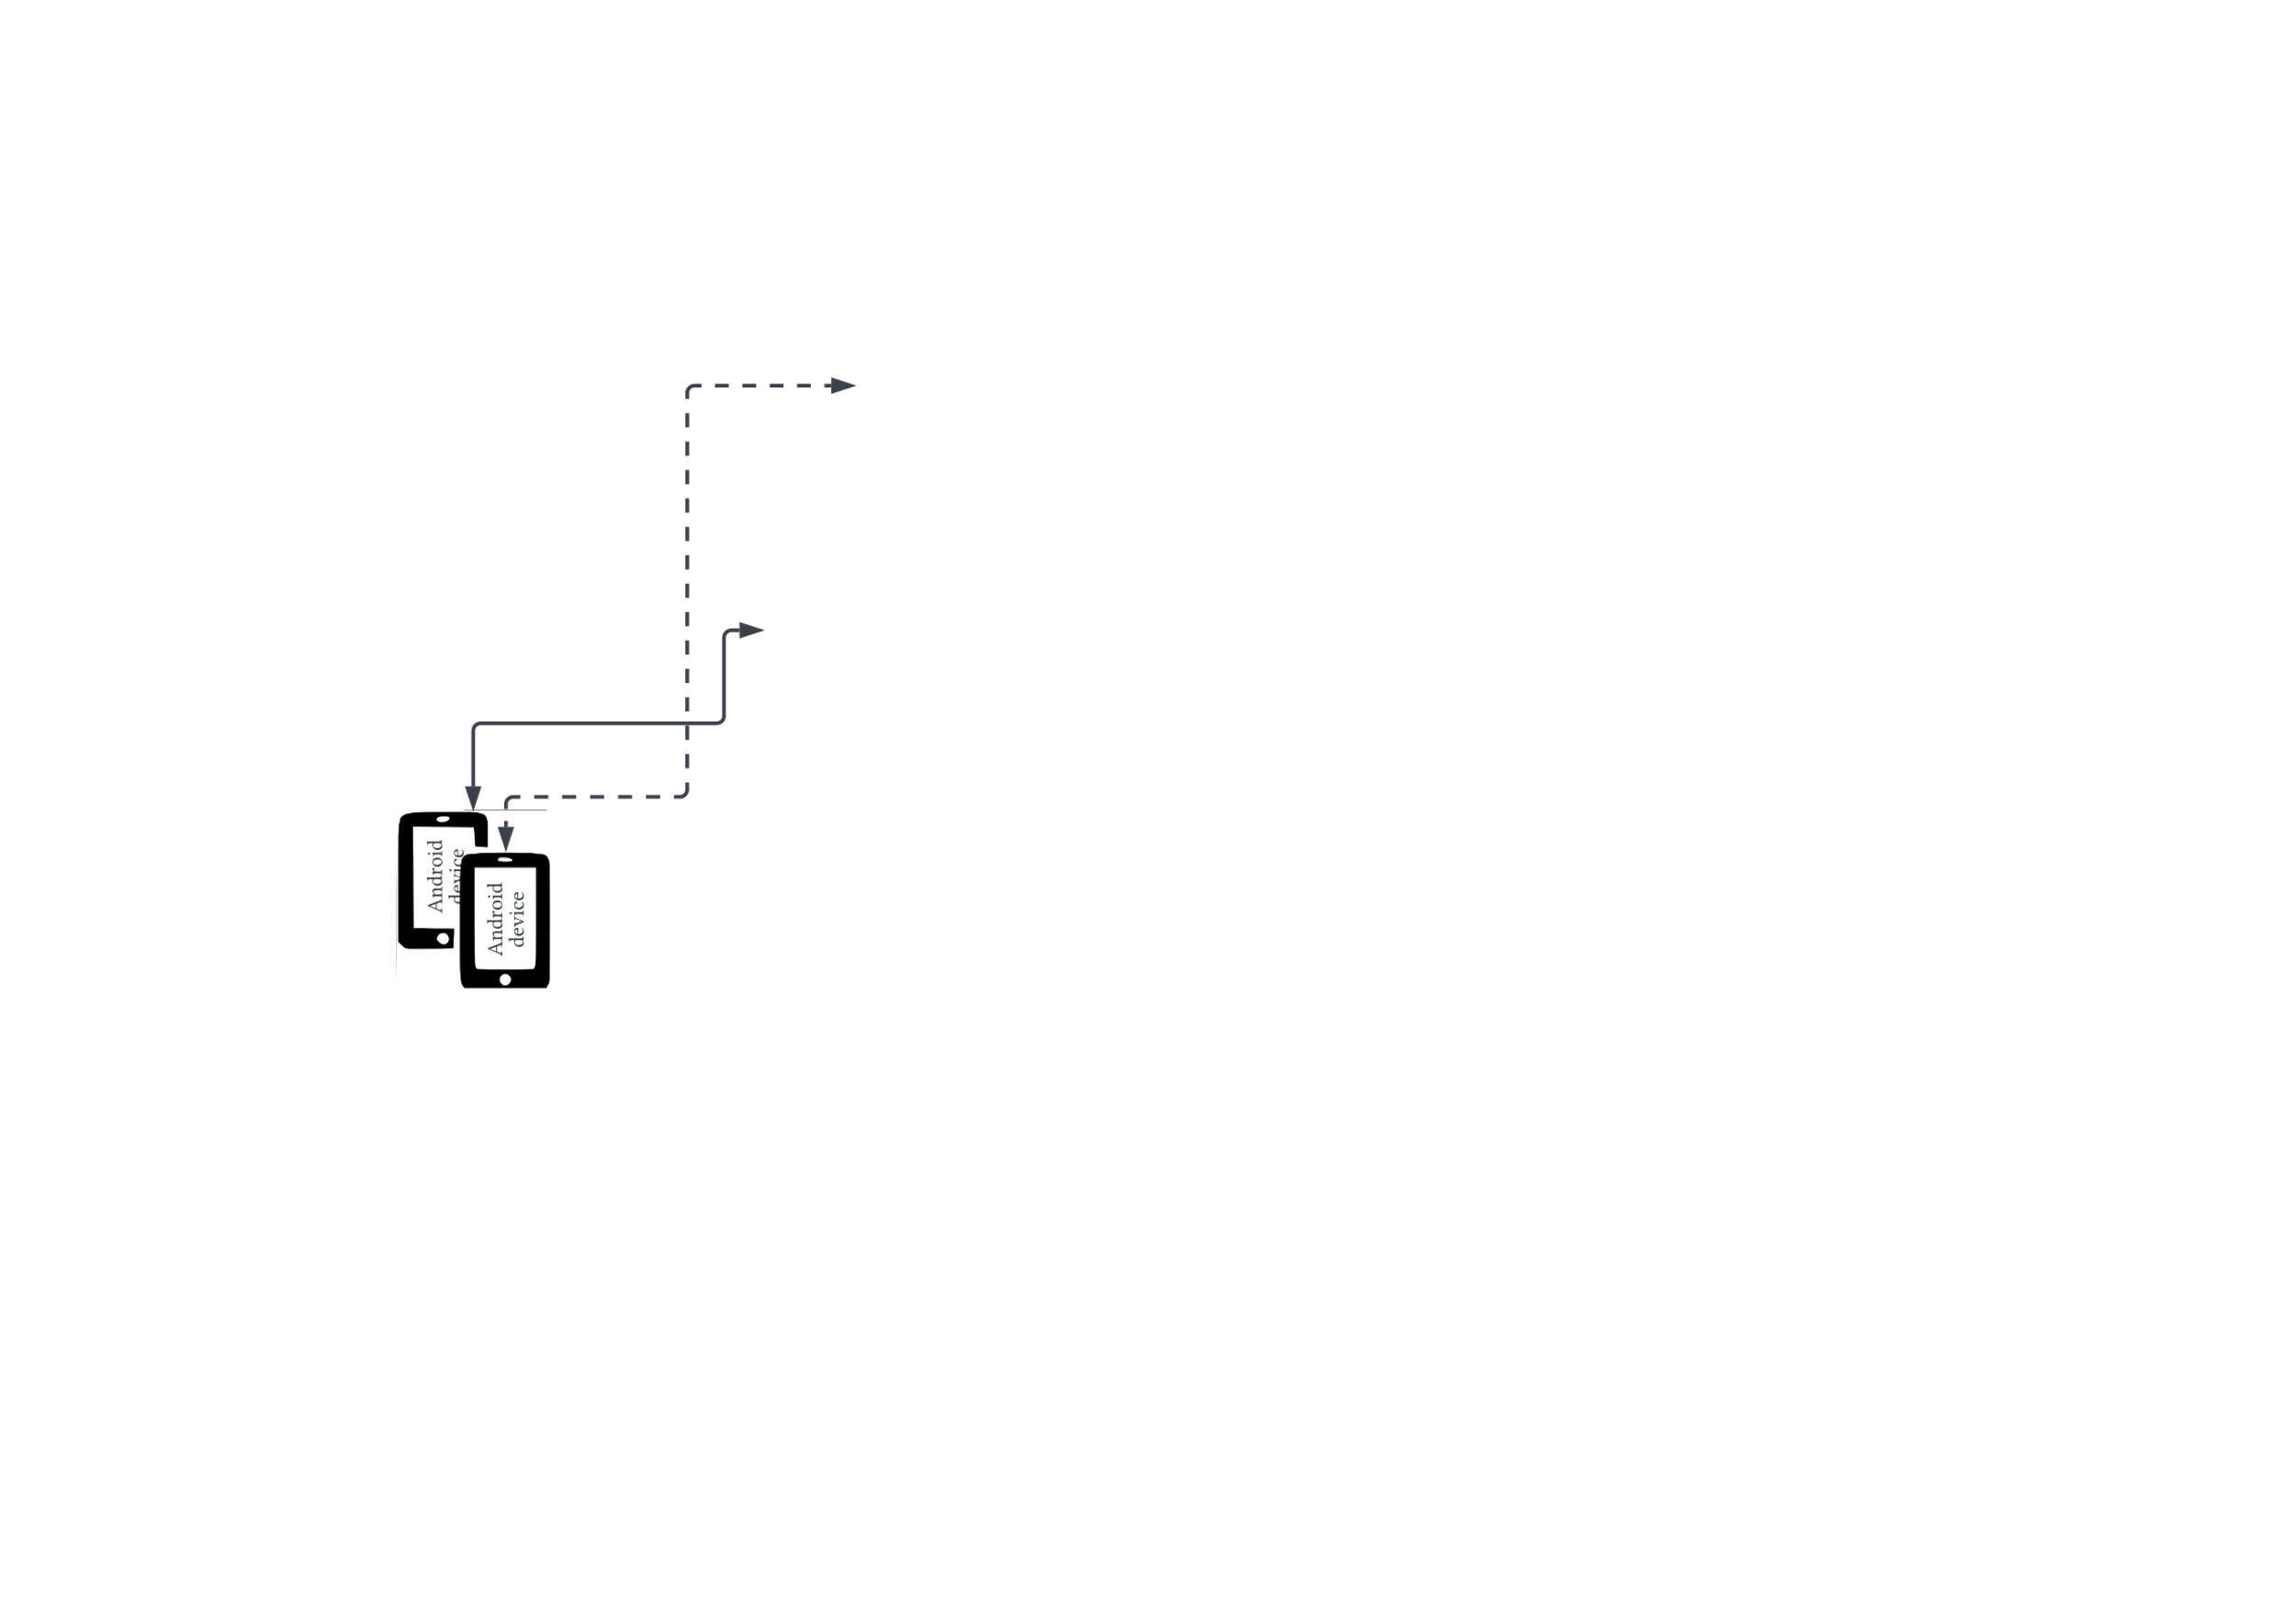
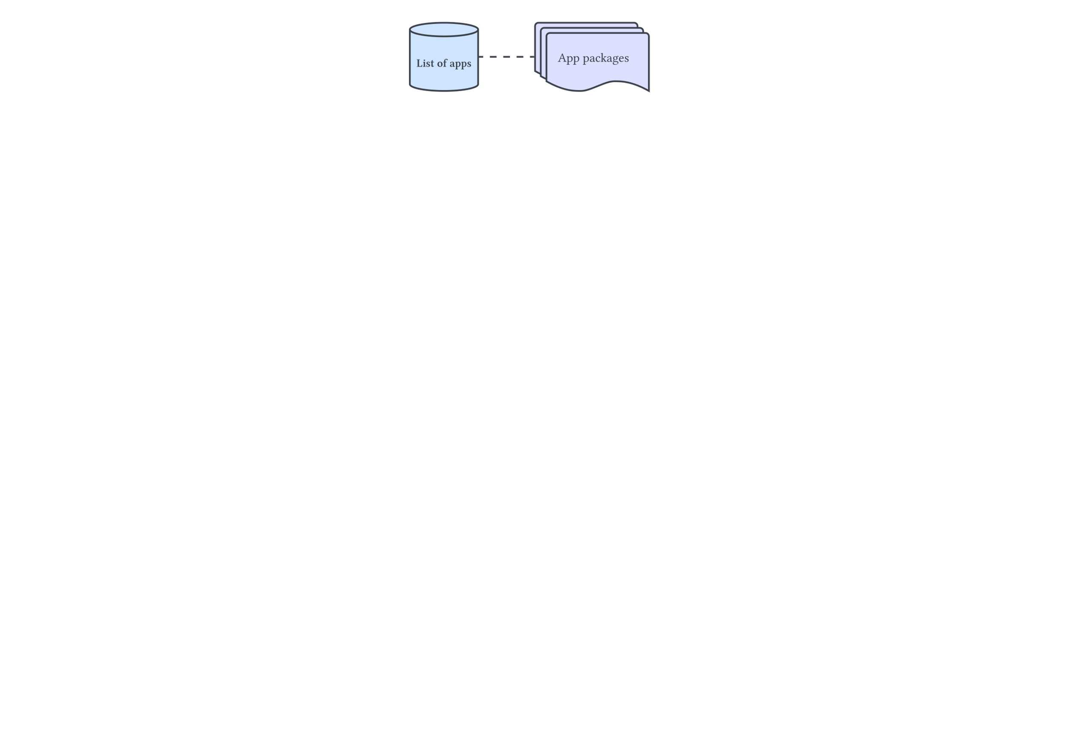
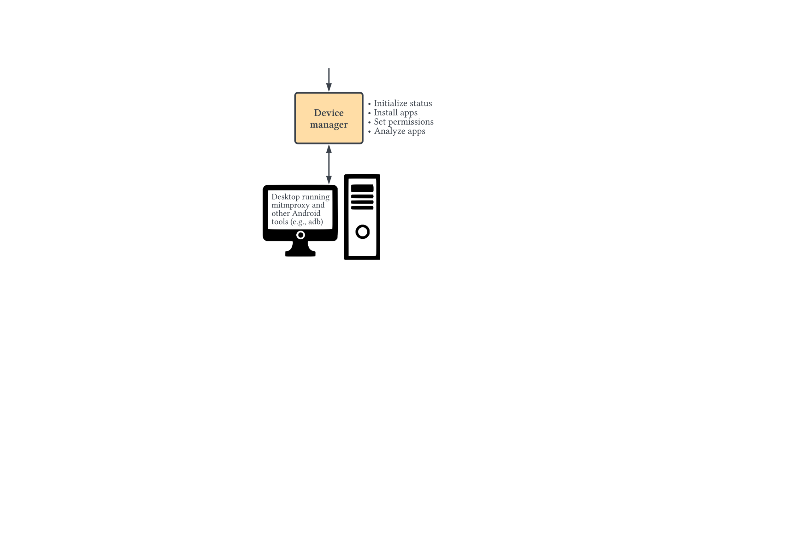
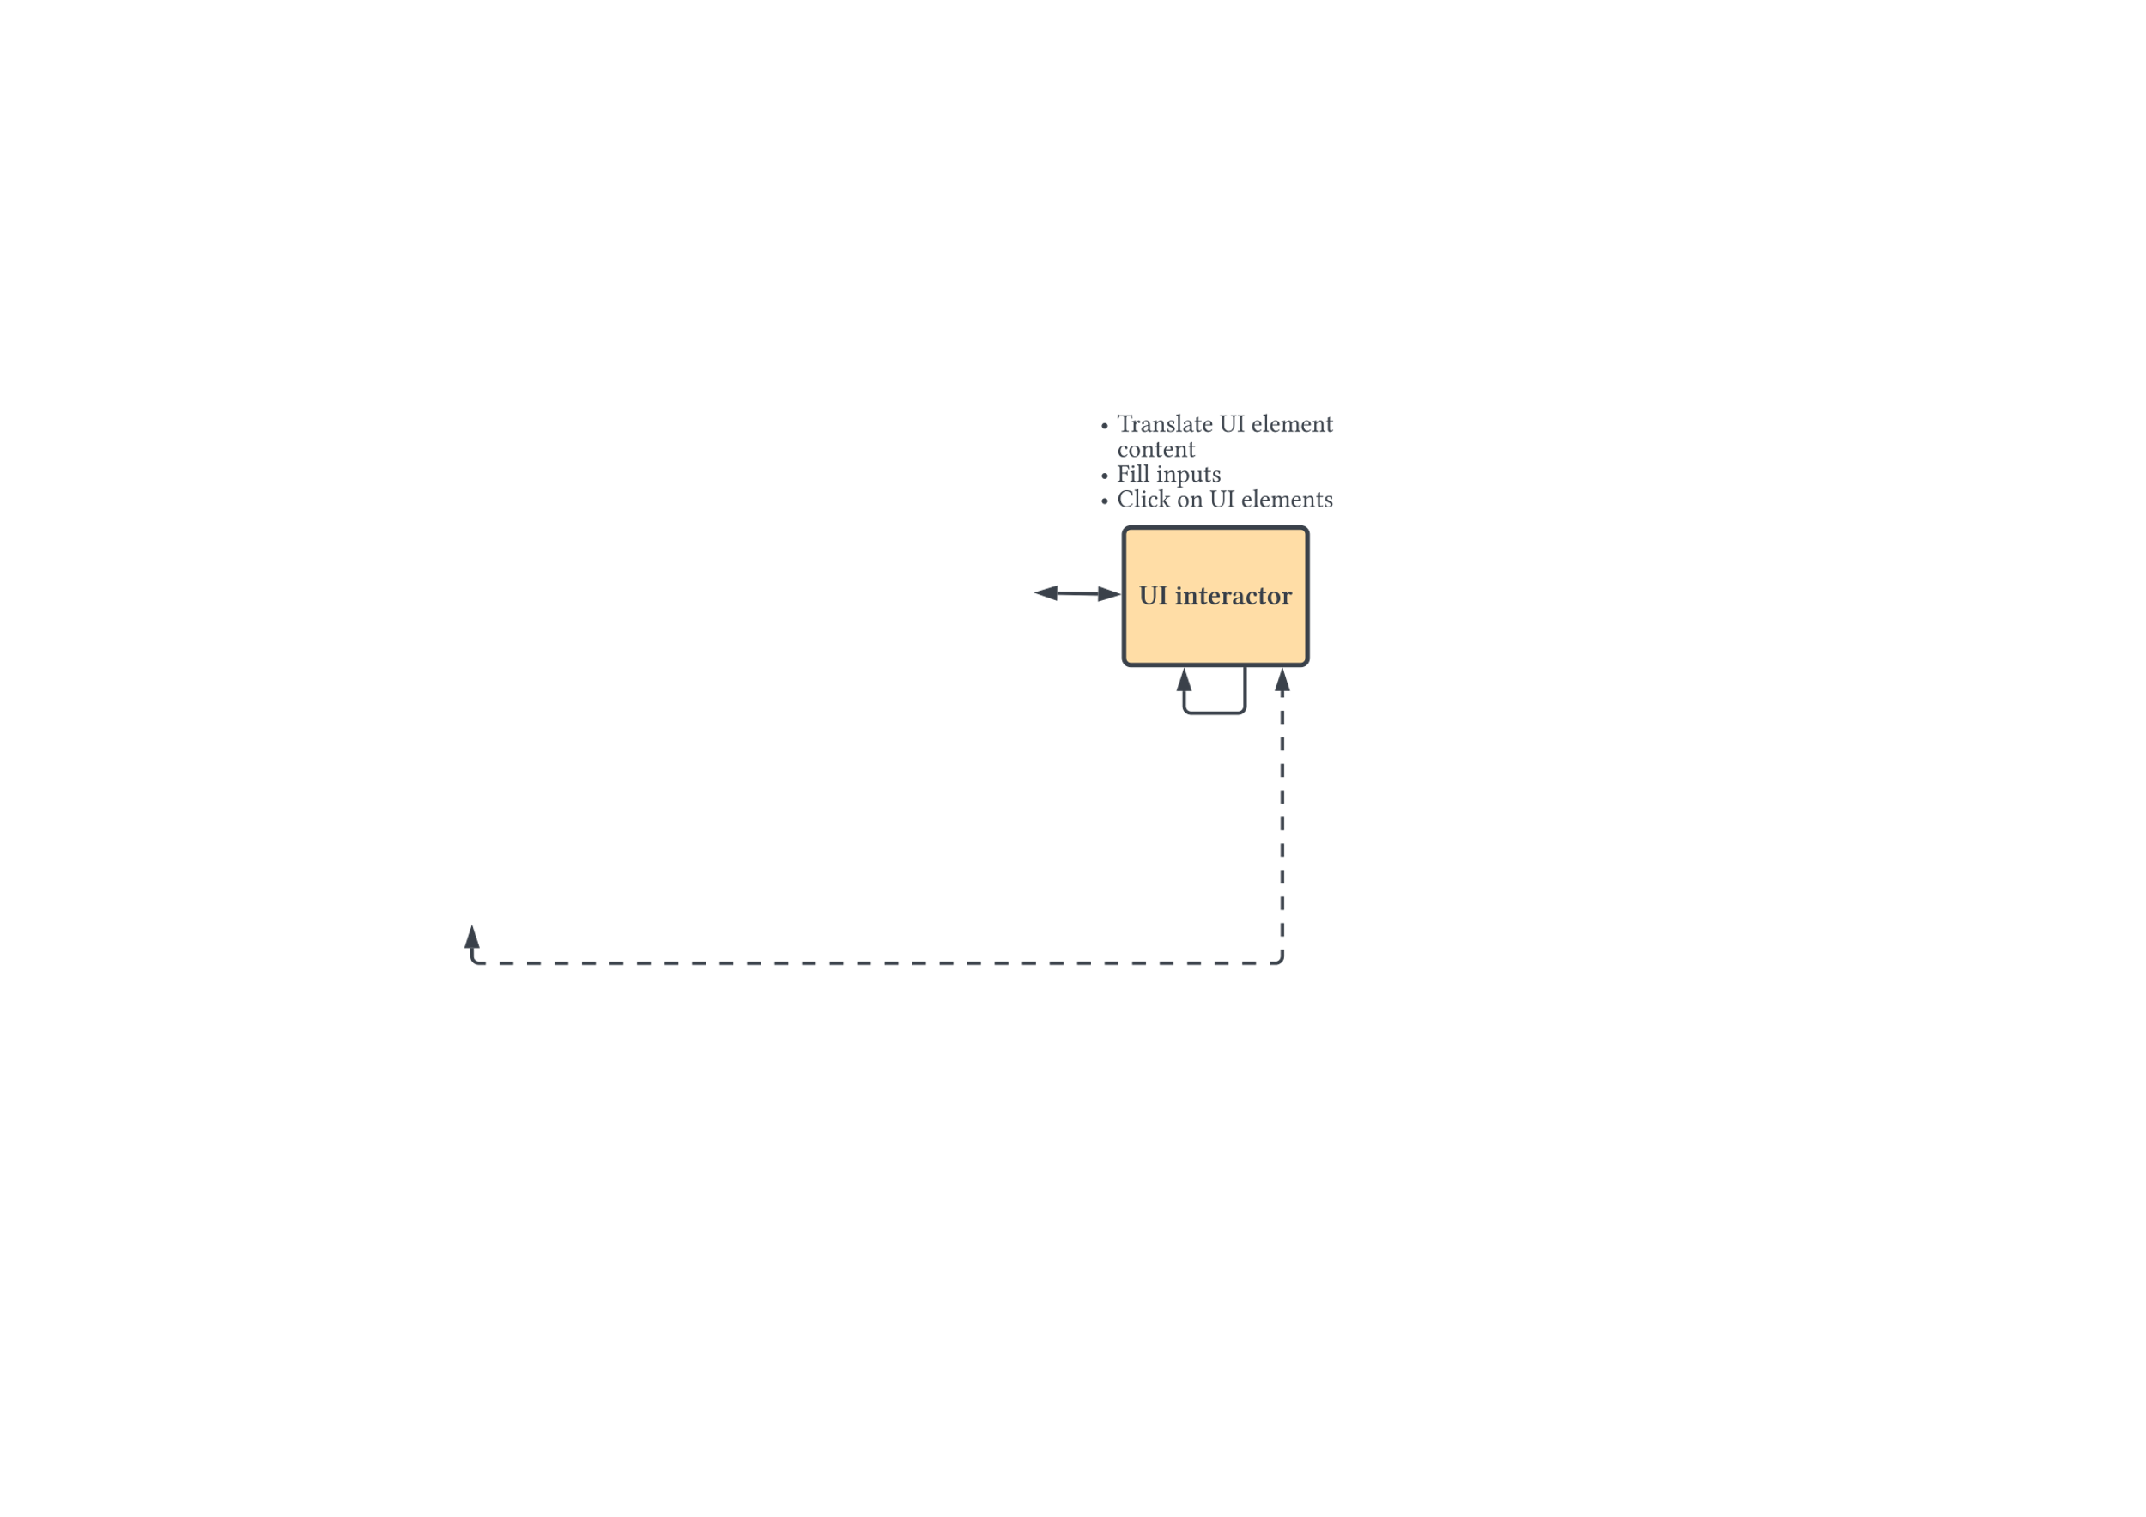
System Architecture

Slide 9
Sample output
{"http": ["model$>f7.baidu.com"], "https": ["wifi-ip$>ppui-static-wap.cdn.bcebos.com", "model$>wappass.bdimg.com", "~lon$<mbd.baidu.com", "KEY|OWFhYTE0NjBhZWE5OTNmYQ==$>sofire.bdstatic.com", "device$>hmma.baidu.com", "IPAddr$>wappass.bdimg.com", "wifi-ip$>wappass.bdimg.com", "packages$>android-safebrowsing.google.com", "session-word$<ppui-static-wap.cdn.bcebos.com", "model$>hmma.baidu.com", "IV|NzUxNjI3NzQyNTQ4MDExMA==$>nsclick.baidu.com"], "non_http": ["token-word$>TCP://157.255.71.209:5288", "token-word$>TCP://14.215.179.43:5288"], "https_crypt": ["wifi-other-essid@1:AES/CBC/NoPadding:MDcxNjI3NzQyMDY3MDExMA==:T2FMaHpPS1RUUUdMdzhoUA==$>nsclick.baidu.com", wifi-essid@2:AES/CBC/NoPadding:NzUxNjI3NzQyNTQ4MDExMA==:T2FMaHpPS1RUUUdMdzhoUA==$>nsclick.baidu.com", "wifi-essid@1:AES/CBC/NoPadding:MDcxNjI3NzQyMDY3MDExMA==:T2FMaHpPS1RUUUdMdzhoUA==$>nsclick.baidu.com", "IPAddr@2:AES/CBC/NoPadding:NzUxNjI3NzQyNTQ4MDExMA==:T2FMaHpPS1RUUUdMdzhoUA==$>nsclick.baidu.com"]}
Communication Types
Data Types
Cryptographic Parameters
Hosts

Slide 10
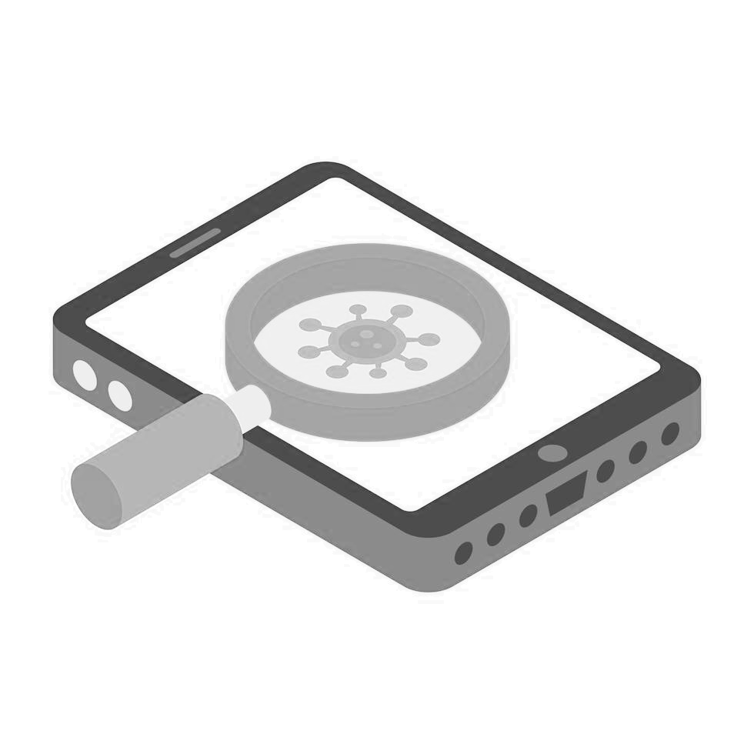
Experiment
Successfully analyzed apps: 12,598
Chosen from androidrank.com
Nov. 25, 2021–Jan. 6, 2022
2x Pixel (4,6) devices with Android 12

Slide 11

Results: Prevalence
6075/12,598 (48.22%) of apps triggered encryption/decryption API
2887/6075 (47.52%) apps used custom encrypted in the network traffic, file storage
22 apps used https for authentication but exposed their token over an insecure non-HTTP (by using custom encrypted)
4 apps used two nested layers of encryption

Slide 12

Results: Encrypted communication channels
Custom Encrypted
Some Hosts
Only
Custom Encrypted
Regular
Custom Encrypted
Android
Device
Android
Device
Android
Device
Android
Device
alice.com
bob.com
alice.com
bob.com
alice.com
bob.com
alice.com
bob.com
Custom Encrypted
Regular

Slide 13
Results: Encrypted communication channels (cont'd)
 | Regular | Custom Encrypted | Custom Encrypted for Some Hosts | Only Custom Encrypted
Device | 12420 | 2350 | 1996 | 1481
Network | 5690 | 1707 | 1681 | 451
Network Location | 266 | 61 | 58 | 51
GPS Location | 2576 | 102 | 95 | 56
User Assets | 1006 | 117 | 109 | 97
Password | 334 | 15 | 15 | 15
Key Transmission | 0 | 263 | 263 | 263
Covered by other methods
Partially covered by other methods
Only covered by ThirdEye

Slide 14



Results: Prominent examples
SHAREit: Transfer, Share Files
1B+ Downloads
Sends device GPS coordinates to third-party domains adcs.rqmob.com and dt.beyla.site by using a custom encryption channel over HTTP
CAIXA
100M+ Downloads
Sends device GPS coordinates and neighbor router information to a third-party party domain evg.dnofd.com
Dailyhunt: News Video Cricket
100M+ Downloads
Sends device contact only over a custom encrypted channel over HTTPS

Slide 15
Limitations
Cannot handle unknown obfuscation techniques
Limited coverage for complex UIs, logins
Cannot bypass advanced dynamic analysis tool detections
Lacks support for: NDK, HTTP/3 (QUIC), DTLS, and raw-TLS

Slide 16

Conclusions
Custom encrypted channels are frequently used in apps
These channels are used by apps from Google Play and other app markets
ThirdEye can automatically detect privacy and security issues in these channels
https://github.com/SajjadPourali/ThirdEye

Slide 18


About Me
I am currently an information and systems engineering Ph.D. student under the supervision of Dr. Mohammad Mannan at Concordia University.
Sajjad Pourali
Research Interests: Mobile, Web and System Security and Privacy, Malware Analysis, Network Application Layer Security
https://pourali.com
s_poural@cisse.concordia.ca
@SajjadPourali

